Slide 1


A multimethod approach to measuring mental representations of threatening others
Nick Michalak and Josh Ackerman
Notes:
I’m Nick Michalak. I’m talking to you from Boulder, CO. For the past five years I’ve been working with Josh on threat perception, infection disease perception in particular. Today I’ll be talking about part of my dissertation work with Josh Ackerman on how people mentally represent threatening others. But, before I start I want to take moment to acknowledge who I’m sharing this award with.

Slide 2
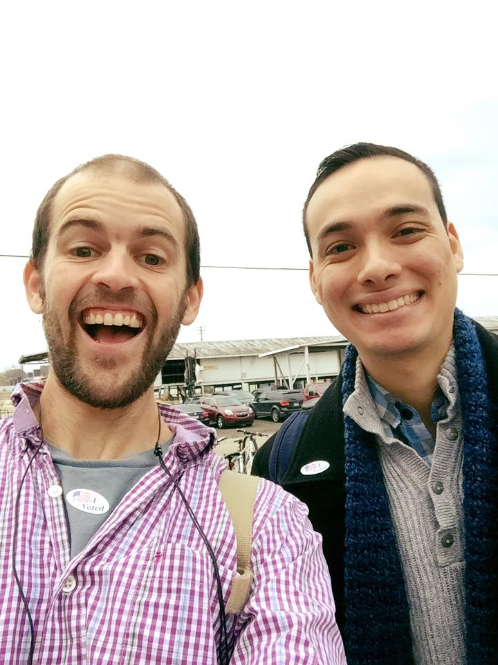
Koji Takahashi & Nick Michalak Brickman Award
(make a plan to vote)
Notes:
As many of you know, Koji and I won this award together! This is Koji and I right before the world ended on November 8th, 2016. Look how happy we were to vote for the first woman president! So this is both a public service announcement to make a plan to vote in November but also I want to say thanks to my friend and helluva scientist Koji Takahashi, who for years listened to be talk about Germy people for hours on end.

Slide 3

We approached mental representations of threats through the lens of our domain of expertise: Infectious disease
Notes:
Now I’ll get started. The work I’m presenting today speaks to how we represent many different kinds of threats, but Josh and I approached this work from the perspective of a particular threat: infectious disease.

Slide 4
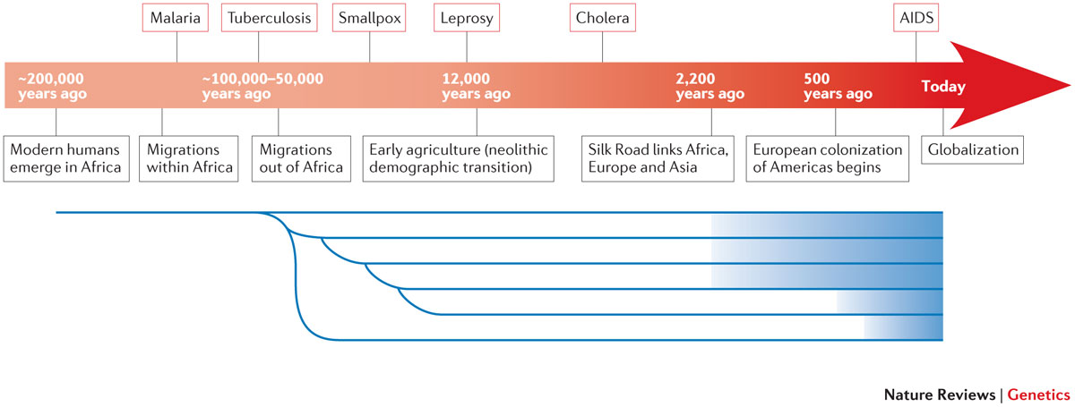
Disease caused by infectious pathogens has imposed an immense selection pressure on the evolution of life for billions of years.
Notes:
The specter of disease caused by infectious pathogens has imposed an immense selection pressure on the evolution of life for billions of years. Human life is no exception. https://www.ncbi.nlm.nih.gov/pmc/articles/PMC4912034/#MOESM1

Slide 5
Estimates suggest infectious diseases have killed more people than all other causes combined Inhorn & Brown, 1990
Meningitis
Hepatitis B
Notes:
In fact, most human lives have ended at the hands of pathogenic infections, and new infections continue to cause many millions of deaths worldwide.
Estimates suggest infectious diseases have killed more people than all other causes combined.

Slide 6
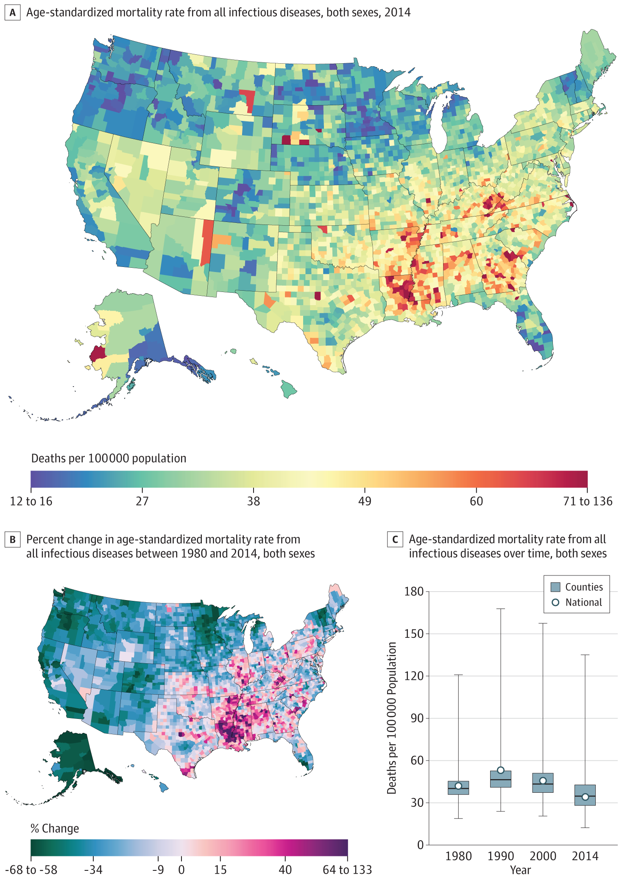
Even in the United States …
Between 1980 and 2014, infectious diseases have killed over 4 million people in the U.S.
Bcheraoui et al., 2018
While I write this talk, over 180,000 people in the U.S. have died from COVID-19.
Our World in Data, 2020
Notes:
Even in the US, between 1980 and 2014, infectious diseases have killed over 4 million people. While I write this talk, over 180,000 people in the U.S. have died from COVID-19.

Slide 7
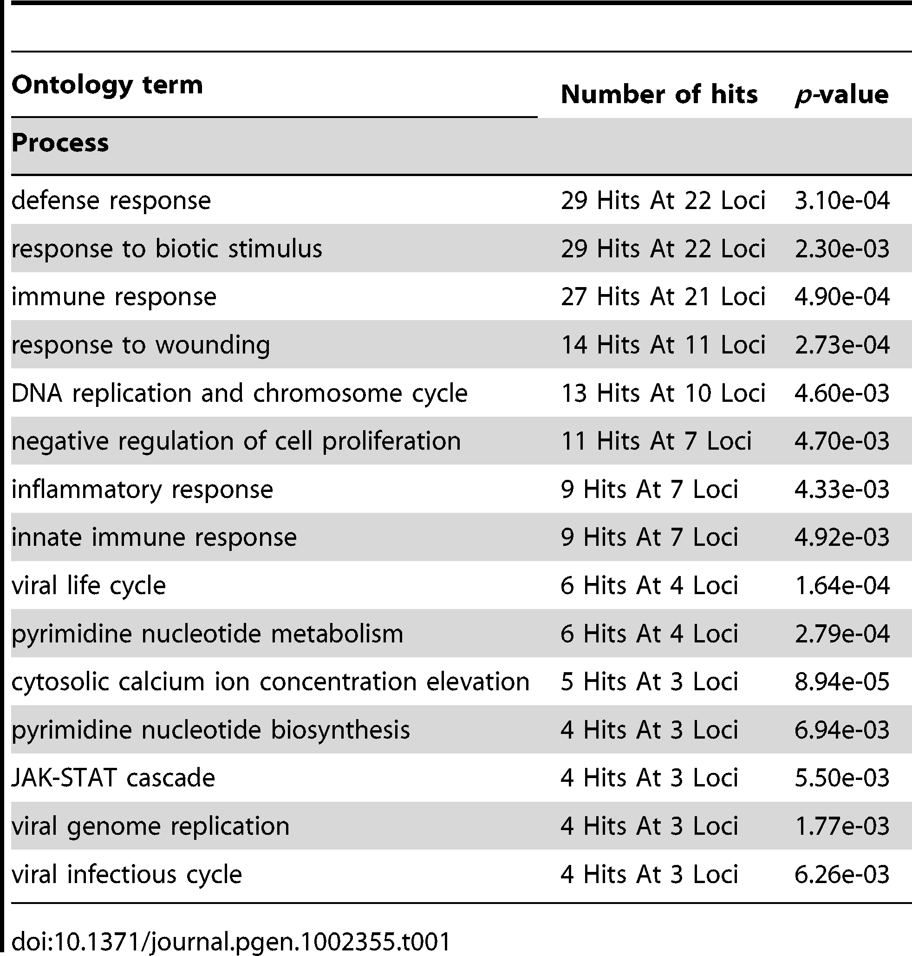
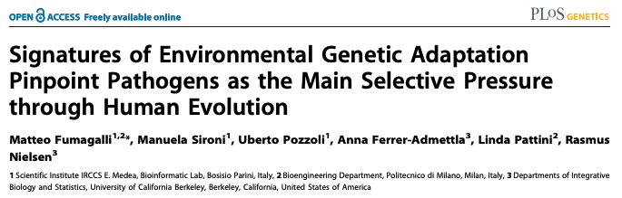
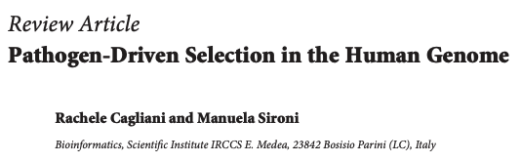
Notes:
So, it shouldn’t be surprising that pathogen and parasite diversity explains variation in genes that function to combat infections.

Slide 8
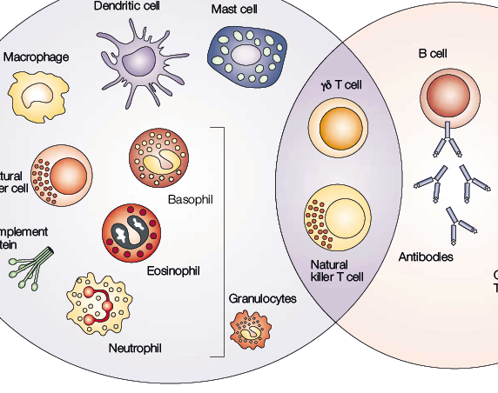
The immune system detects, deflects, and eliminates invading pathogens
Notes:
In other words, over evolutionary time, humans have developed sophisticated physical machinery—an immune system—for identifying invasive pathogens and eliminating them.

Slide 9

The immune system also costs valuable energy that could be used elsewhere
Notes:
Of course, the immune system costs valuable energy, so completely ignoring harmful pathogens until they enter the body wastes energy that could be used for other fitness-enhancing activities.

Slide 10

The behavioral immune system
A suite of psychological and behavioral mechanisms designed to detect the presence of pathogens and engage appropriate cognitive, emotional, and behavioral responses to avoid them
Notes:
To reduce these costs, humans have likely developed psychological and behavioral mechanisms—a behavioral immune system—for identifying and mitigating pathogen infection risks.

Slide 11
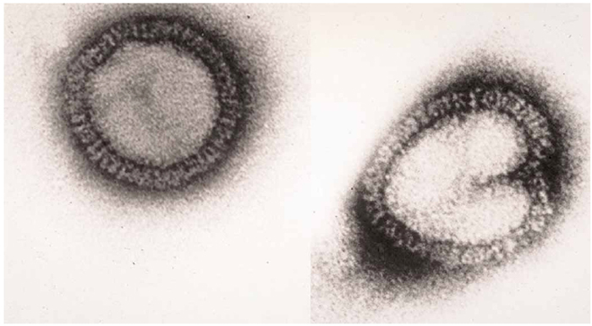
People can’t see pathogenic infections directly
80-120 nanometers
Influenza A
Notes:
The behavioral immune system cannot detect infectious pathogens directly. For example, a particle of the Influenza A virus is approximately 80-120 nanometers in diameter, which is about 20 thousand times smaller than a standard pencil tip. So there’s no way we could detect pathogens just by looking at them.
https://www.nature.com/scitable/content/electron-micrograph-of-influenza-a-virus-particles-26862/

Slide 12
People infer the presence of infection from cues
Measles
Mumps
Yellow Fever
Notes:
So instead of perceiving infectious pathogens directly, people rely on cues that correlate with infection. These cues are often noticeable in appearance because infection can cause rashes, lesions, discoloration, swelling, bleeding, and/or nasal discharge, among other physical changes.

Slide 13
23/25 (92%) of most deadly infectious diseases cause symptoms visible in the face
Measles
Mumps
Yellow Fever
Ryan, Oaten, Stevenson, & Case, 2012; Wolfe, Panosian, & Diamond, 2007
Notes:
For example, many of the most deadly infectious diseases cause visible symptoms in the face.

Slide 14
More facial features look like infection than are actually diagnostic of infection Barrett & Kurzban, 2006; Schaller, 2015; Sperber, 1994
Looks Infected
Is Infected
Notes:
Of course, there are many more facial features that look like infectious disease than are actually diagnostic of infectious disease.

Slide 15
Wide variability in infectious disease symptoms (and look-alikes) Detection errors are inevitable
Haselton et al., 2015; Haselton & Buss, 2000; Haselton & Nettle, 2006; McKay & Efferson, 2010; Nesse, 2005
Notes:
There is variability in diseases and in symptoms. Diseases change and evolve. There is variability in what looks like disease. Thus, facial features are imperfect diagnostic cue for infection. If you rely on only these kinds of cues, errors are inevitable.

Slide 16
False negative errors are more costly than false positive errors
Truly infected
Truly benign
Treat as infected
True Positive | False Positive
False Negative | True Negative
Treat as benign
Notes:
But not all kinds of errors come with the same costs. Failure to identify a dangerous pathogen’s presence (e.g., mistaking swelling from deadly Diphtheria as benign) is far costlier to fitness than mistakenly inferring a parasitic threat that is not there (e.g., mistaking a birthmark as an infectious rash).

Slide 17
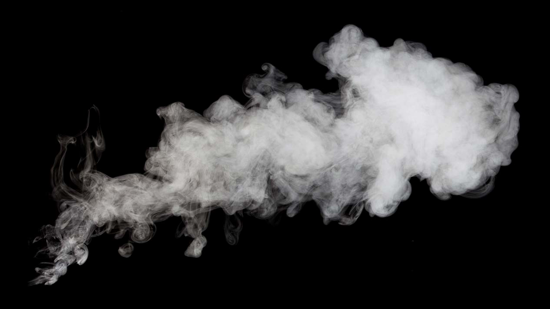
Natural selection could have favored a cognitive bias toward over-perceiving pathogen threats in anomalous cues
Haselton et al., 2015; Haselton & Buss, 2000; Haselton & Nettle, 2006; McKay & Efferson, 2010; Nesse, 2005
Notes:
One solution to this problem is to allow for bias in favor of the less costly error, like how smoke-detectors sound alarms even when there is no fire. When it comes to detecting pathogens, natural selection could favor a cognitive bias that reduces fitness costs by over-perceiving pathogen threats in anomalous cues.

Slide 18
Infection concerns may partly explain stigma directed toward some groups
Obesity
Port-wine stain birthmarks
Old Age
Park, Schaller, & Crandall, 2007
Ryan, Oaten, Stevenson, & Case, 2012
Duncan & Schaller, 2009
Notes:
Researchers who study pathogen avoidance psychology have used this adaptive over-perception to partly explain stigma directed toward people with anomalous yet benign facial features such as obesity, port-wine stain birthmarks, strabismus (i.e., crossed-eyes), old age, and physical disabilities.

Slide 19
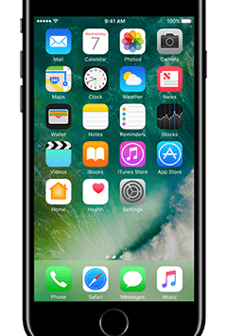
Researcher Assumptions
The behavioral immune system comprises functional mental modules
It comprises cognitive mechanisms with specialized functions with restricted inputs
Barrett, 2012; Barrett & Kurzban, 2006; Schaller, 2016; Sperber, 1994; Sperber & Hirschfeld, 2004
Notes:
To understand the behavioral immune system’s tendency to perceive infection in non-infectious features, researchers in this area assume that the behavioral immune system is a functional module of the mind—it comprises cognitive mechanisms with specialized functions with restricted inputs.

Slide 20
One or many cognitive mechanisms of the behavioral immune system function to detect pathogens
Notes:
In the context of pathogen threat, one or many mechanisms of the behavioral immune system function to detect pathogens.

Slide 21
Disease Detection Inputs Proper vs. Actual
Actual
Proper Domain. Set of inputs the module was designed by natural selection to process
Actual Domain. Broader set of inputs the module is able to process
Proper
Barrett, 2012; Barrett & Kurzban, 2006; Schaller, 2016; Sperber, 1994; Sperber & Hirschfeld, 2004
Notes:
To detect pathogens, behavioral immune system processes inputs reflecting true signs of infection: the proper domain. These are the cues the behavioral immune system evolved to process, such as infectious rashes and pox. And because these cues share perceptual properties with many others, the behavioral immune system is able to process a broader set of cues: the actual domain, which includes infectious rashes and pox but also acne and burn scars.

Slide 22
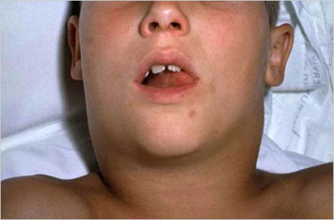
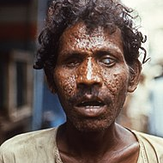
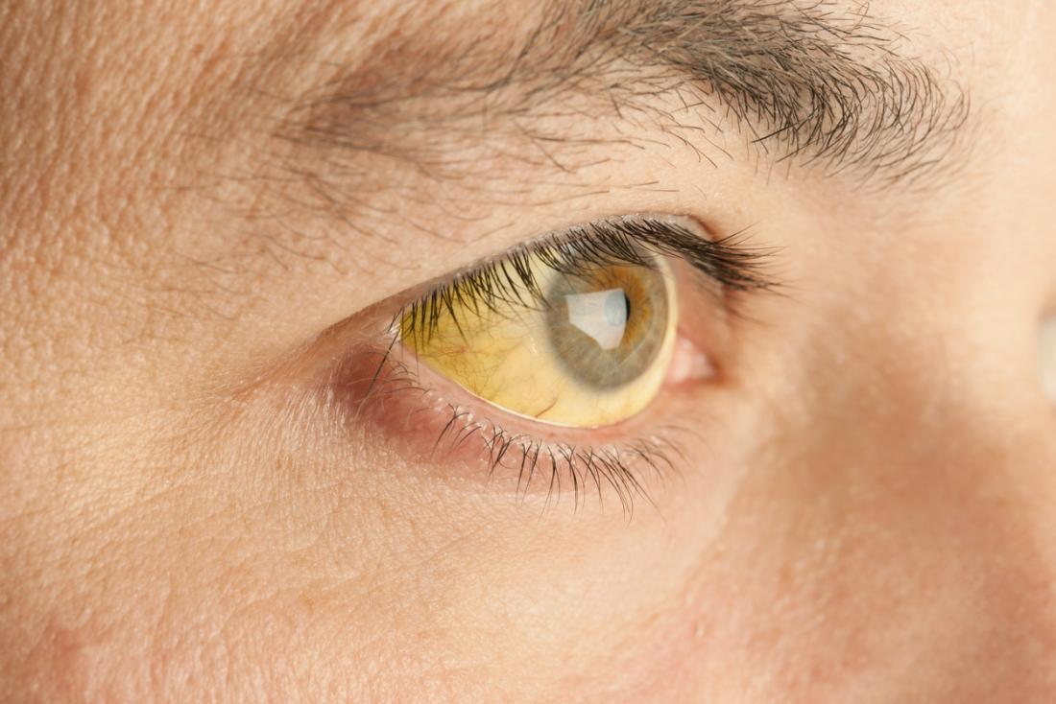
The behavioral immune system should react to true infection cues
Diphtheria
Smallpox
Yellow Fever
Notes:
So, theoretically, the behavioral immune system should react to true infection cues …

Slide 23
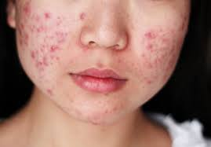
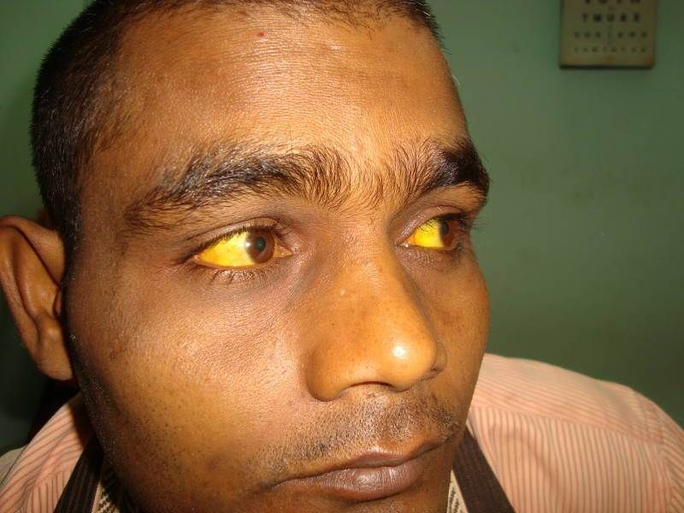
The behavioral immune system should react to cues that resemble true infection cues
Acne
Acute liver failure
Obesity
Notes:
And it should also react to false infection cues if such false infection cues share perceptual properties of true infection cues.

Slide 24
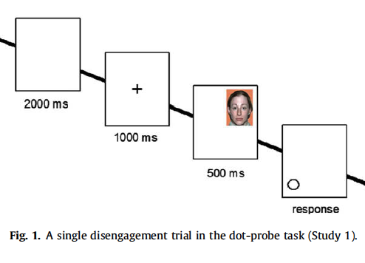
Ackerman et al., 2009, JESP
Randomly assigned to view slide-shows:
Pathogen Threat Condition: dirty sponge, a sneezing person
Control Condition: public buildings
Completed visual attention task for Disfigured Faces vs. Typical Faces
Notes:
Researchers have tested this over-perception hypothesis using a variety of methods. For example, in one study, Ackerman et al. randomly assigned participants to watch either a slideshow of pathogenic objects and people like dirty sponges and sneezing or a slideshow that depicted pathogen-irrelevant objects like public buildings. After the slideshow, they completed a visual attention task (the dot-probe) which measured how long it took participants to pull their visual attention away from disfigured vs. typical faces.

Slide 25
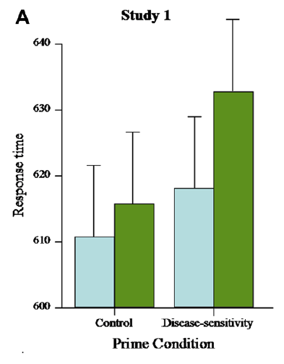
People who watched the pathogen threat slideshow took longer to pull away visual attention from disfigured faces
Ackerman et al., 2009, JESP
Notes:
They found that People who watched the pathogen threat slideshow took longer to pull away visual attention from disfigured faces. This suggests people were attending more to anomalous yet benign facial features when pathogen infection was salient as if those features indicated infection risk.

Slide 26
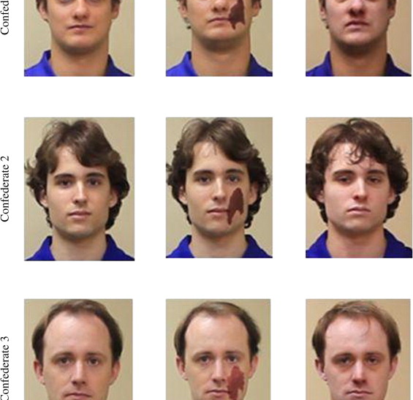
Ryan et al., 2012, EHB
Confederates were videotaped touching a variety of props to their hands, heads, faces, and mouths (e.g., towel, harmonica, snorkel mask)
Confederates appeared healthy, with a port-wine stain birthmark, or with the Flu
Participants were asked to watch videos and imitate the confederates by touching the same objects
Measured imitation behavior, disgust expressions, and disgust behavior
Notes:
In another study, Ryan et al. videotaped confederates touching a variety of props. Some confederates appeared healthy, others were made to look like they had the flu, and others had a port-wine stain birthmark. Participants then watched these videos and were asked to imitate the confederates. The researchers coded videos of the participants disgust expressions, disgust behavior, and touching behavior.

Slide 27
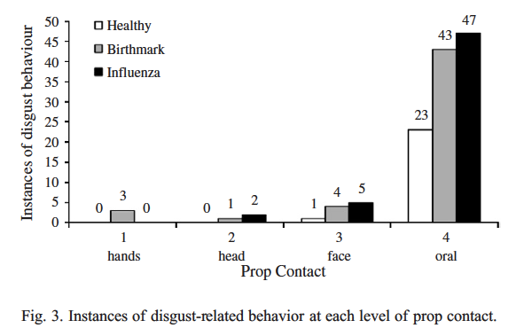
People acted like port-wine stain birthmarks were infectious
Ryan et al., 2012, EHB
Notes:
People were more disgusted by and were less willing to touch objects that had been touched by people with visible cues of influenza compared to the same objects that had been touched by visibly healthy targets (Ryan et al., 2012). People also expressed more disgust by and less willingness to touch those objects when the target people bore non-infectious facial blotches, suggesting participants perceived features that merely resembled infection cues as if they were true indicators; that perception made them avoid touching objects that had been “contaminated” through physical contact.

Slide 28
Park, Schaller, & Crandall, 2007, EHB
Randomly assigned to view slideshows:
Pathogen Threat Condition: germs, infections, pathogen prevalence
Accident Threat Condition: bathtub electrocution
Work Ethic Condition: hard work, “no pain, no gain”
Completed Fat-Disease Implicit Association Tests
Quickly categorized words as related to disease or health and faces as fat or thin
Notes:
As one last example, Park, Schaller, and Crandall randomly assigned participants to watch one of three slideshows: pathogen threat, accident threat, or work ethic. And then participants completed an Implicit Association Test in which they quickly categorized words as related to disease or health and faces as fat or thin.

Slide 29
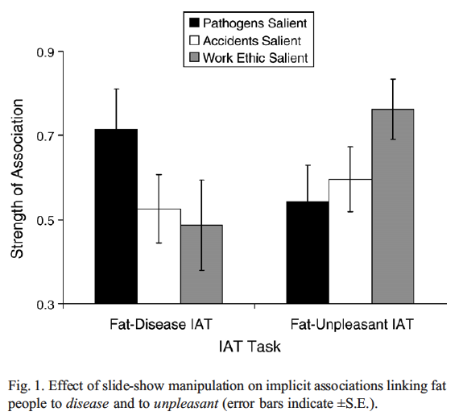
People who watched the pathogen threat slideshow recorded stronger negative associations with obese targets
Park, Schaller, & Crandall, 2007, EHB
Notes:
They found people for whom pathogen threat was salient recorded stronger automatic negative associations with obese targets than people in a control condition (Park et al., 2007)

Slide 30

Results support the hypothesis that people misperceive infection risk in objectively benign features that resemble infection cues
Notes:
Altogether, these results support the hypothesis that people misperceive infection risk in benign features that share perceptual properties with true infection indicators (e.g., rashes, swelling).

Slide 31

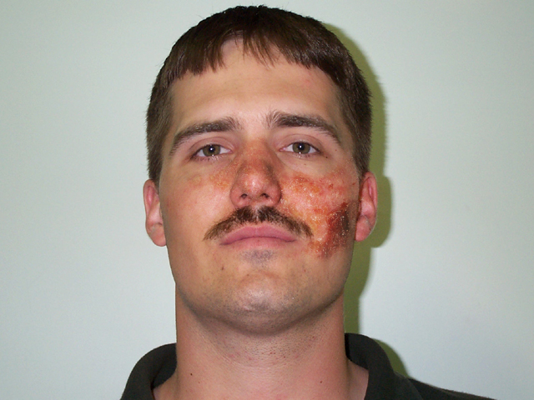
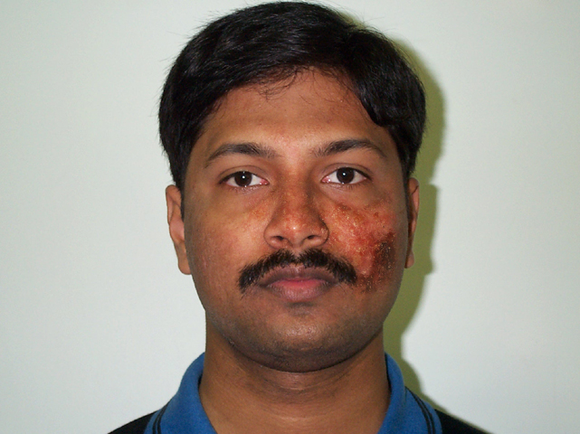

Is “foreign appearance” perceived in ethnic out-groups an infection cue?
Notes:
Researchers have extended this over-perception hypothesis to include cues that less plausibly resemble true infection indicators but nonetheless could be associated with harmful pathogens. The most prominent example is foreign appearance perceived in ethnic outgroups.

Slide 32
Evidence suggests people more concerned about pathogens report stronger negative attitudes toward ethnic outgroups
Aarøe et al., 2017; Faulkner et al., 2004; Huang et al., 2011; Navarrete & Fessler, 2006; Schaller & Neuberg, 2012
Notes:
Evidence suggests people more concerned about pathogens report stronger negative attitudes toward ethnic outgroups

Slide 33
Adaptation-for-Outgroups Hypothesis
Individuals from ethnic out-groups may harbor pathogens that individuals from the in-group have not developed immunity against
Cues associated with ethnic outgroups may elicit responses that at least indirectly limit exposure to people from these groups
van Leeuwen and Petersen, 2018
Notes:
The standard explanation is that individuals from ethnic outgroups may harbor pathogens that individuals from the ingroup have not developed immunity against, so cues such as skin color and other physical features associated with such ethnic outgroups may elicit psychology and behaviors that at least indirectly limit exposure to individuals from these groups (e.g., negative attitudes, prejudice, hostility, avoidance).

Slide 34
Or people learn and transmit information about pathogen avoidance
The adaptation-for-outgroups hypothesis holds that the behavioral immune system was designed to process foreign appearance as an infection cue
But people may learn to associate ethnic outgroups with harmful pathogens even if objectively they’re not
van Leeuwen and Petersen, 2018
Notes:
Alternatively, the behavioral immune system may include design features for learning and transmitting information about avoiding pathogens, which could include stereotypes and experiences linking ethnic outgroups with infection (Fessler et al., 2015).

Slide 35
van Leeuwen and Petersen, 2018
Randomly assigned Indian or White American participants to look at pictures of Indian or White American people with or without infectious rashes on their face
Participants reported how comfortable they’d be sitting next to the pictured people
Notes:
van Leeuwen and Petersen designed a study to test the adaptation for outgroups hypothesis. They randomly assigned Indian or White American participants to look at pictures of Indian or White American people with or without infectious rashes on their face. Participants reported how comfortable they’d be sitting next to the pictured people.

Slide 36
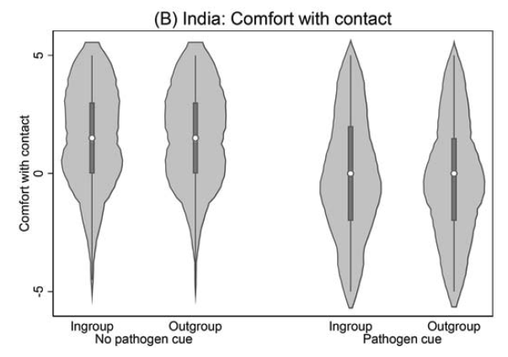
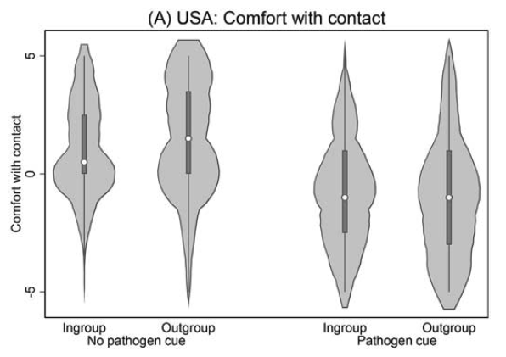
Both Indian and White participants felt less comfortable sitting next to a person with the pathogen cue regardless of in/outgroup status
van Leeuwen and Petersen, 2018
Notes:
They found evidence that people are uncomfortable sitting next to people with an pathogen cue on their face but they did not find support for the adaptation for outgroups hypothesis.

Slide 37
Remember these points
The behavioral immune system reacts to cues that correlate with infection
Such cues include objective infection cues as well cues that look like them
Some results suggests people overperceive infection in benign cues that superficially resemble infection cues
Notes:
OK, I have some takeways for you. First, the behavioral immune system reacts to cues that correlate with infection. Such cues include objective infection cues as well cues that look like them. Some results suggests people overperceive infection in benign cues that superficially resemble infection cues.

Slide 38
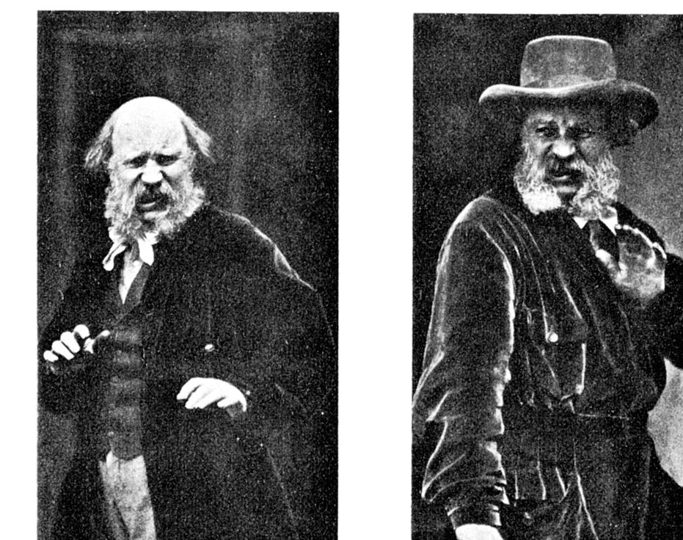
People respond to infection cues, real of perceived
Notes:
So, people have specific reactions to infection cues.

Slide 39

But how do people see infected people in their minds?
Notes:
But what does an infected person look like? In your mind, you might picture someone pale and weak, someone with a runny nose and watery eyes, or someone with facial rashes and sores. Whichever features appeared in your mind’s eye, where did they come from? Many of you probably imagined features based on intuition, experience, and stereotypes. Or maybe you imagined some of the features I’ve been talking about for the last 10 minutes or so.

Slide 40

Mental representations partly depend on expectations
Notes:
Put differently, mental representations depend partly on expectations. Researchers have representations. Normal people who end up in studies have expectations. What we expect affects what we imagine, what we study, and how we study it.

Slide 41
Infected People Features?
Disfigured or Asymmetrical
Obese
Old
Unhealthy
Rashes or blotchiness
Crossed-eyes
Notes:
During my first semester in graduate school, Josh and I were interested in how people mentally represented infected people. Based on the behavioral immune system literature, we expected them to have at least some of the features I’ve been talking to you about for the past 10 minutes.

Slide 42
Threat Specificity
Different threats entail different psychological and behavioral solutions
Notes:
In other words, we expected people to mentally represent threating others features that are specific to the threat they pose. The idea is that people need to be able to recognize and imagine what specific threats look like because different threats require different psychological and behavioral solutions. People process and react to sick individuals differently than they do violent individuals. This is, in part, because effectively avoiding infection requires different behaviors than avoiding violence.

Slide 43

Wash your hands to avoid getting sick
Notes:
For example, one washes their hands to avoid getting sick when interacting with someone who coughs and sneezes, …

Slide 44

Raise your hands to avoid injury if someone brandishes a weapon
Notes:
whereas one raises their hands to avoid injury when interacting with someone who brandishes a weapon.

Slide 45


Natural selection has favored mental systems that enable people to perceive, feel, think, and behave in ways to reduce threats in-particular rather than threats in-general
Barrett, 2012; Cosmides & Tooby, 1994; Holbrook & Fessler, 2015; Neuberg et al., 2011; Tooby & Cosmides, 1992
Notes:
From what I refer to as the functional threat management perspective, natural selection has favored mental systems that enable people to perceive, feel, think, and behave in ways to reduce threats in particular rather than threats in general (Barrett, 2012; Cosmides & Tooby, 1994; Holbrook & Fessler, 2015; Neuberg et al., 2011; Tooby & Cosmides, 1992). This perspective does not imply that specific threats always elicit specific responses (e.g., most threats elicit anxiety due to shared processing mechanisms), but a fully general response to all threats would be less efficient than responses targeting the unique affordances of each threat.

Slide 46
Evidence suggests people exhibit functional responses to specific threat cues Neuberg et al., 2011
Notes:
Consistent with this perspective, a growing body of evidence suggests people exhibit functional responses to specific threat cues. I’ve talked to you a ton about pathogen threats, so I shift to violence threats.

Slide 47
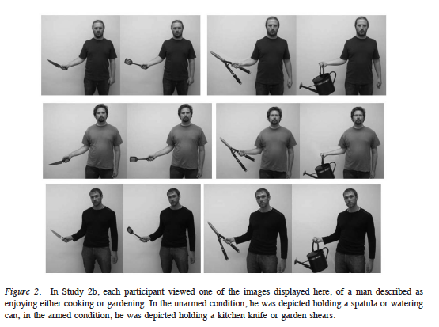
Holbrook et al., 2014, Emotion
Randomly assigned to evaluate people holding harmless objects or potential weapons
Rated trait and state anger, fear, and disgust
Notes:
Holbrook et al. randomly assigned participants to evaluate people who were either holding harmless objects or objects that could plausibly be used as weapons. They rated the targets’ state and trait emotions like anger, fear, and disgust.

Slide 48
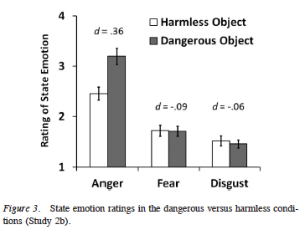
People estimated greater state and trait anger in men holding household items that could be used as weapons
Holbrook et al., 2014, Emotion
Notes:
They found that people estimated greater state and trait anger in men holding household items that could be used as weapons (e.g., garden sheers) compared with men holding objects that are less plausible as weapons (e.g., a watering can) (Holbrook et al., 2014). Thus, a threat-specific cue elicited a functional response: People perceived men holding plausible weapons as more prone to anger.

Slide 49


Other research has linked aggression threat to formidable physical features such as size and weight Fessler et al., 2012
Notes:
Other research has linked aggression threat to formidable physical features such as size and weight Fessler et al., 2012. So, theoretically, people process threatening others in threat-specific ways. Some studies on pathogen threat and violence threat support this hypothesis.

Slide 50
Researchers often test one anomalous facial feature at a time Feature present vs. absent
Disfigured vs. Normal Ackerman, et al., 2009
Obese vs. Normal Miller & Maner, 2012
Old vs. Young Duncan & Schaller, 2009
Notes:
Many of the studies in these functional threat management literatures are limited in at least two key ways. First, researchers pick cues to represent threat cues and they often compare them to neutral or cue absent conditions. So results based on a few cues employed across a handful of studies may not generalize to a more representative universe of cues.

Slide 51



People may mentally represent threats with different cues than those they react to (and vice versa)
Notes:
Second, all the studies test hypotheses about how people react to threat cues. It’s possible that reactions to threat cues mean that people represent threats in their minds with those cues, but it’s also possible that people represent threats with different cues than the one they react to.

Slide 52

People rate younger faces more trustworthy than older faces Zebrowitz & Franklin Jr, 2014
But do you think of trustworthy people as young?
Notes:
As one example, there’s a robust finding that people rate younger adults more trustworthy than older adults. If you flip this around and ask people to list traits of trustworthy people or imagine what a trustworthy person looks like, they might not list young or imagine young people. So reactions to stimuli don’t necessarily tell you how people represent a social category.

Slide 53
Our Expectations
Threat representations will appear with threat-specific cues
Threat representations will posses some unexpected features
Notes:
So, to sum all this up, based on the functional threat management literature, we expected infected mental representations to be threat specific. And we had some good reasons to expect mental representations tell us something a little different than studies that measure reactions to threat stimuli.

Slide 54

Threat-Specific Hypothesis
Threat representations will primarily include cues specific to and diagnostic of that threat
Notes:
We developed two hypotheses for how infected representations could look. The first hypothesis we called the threat-specific hypothesis. The threat-specificity hypothesis predicts that threat representations will primarily include cues specific to and diagnostic of that threat.

Slide 55

Threat-Combination Hypothesis
Threat representations will include a combination of threat cues common across multiple types of threats
Notes:
The second hypothesis—what I label the threat-combination hypothesis—is the natural complement to the first. The threat-combination hypothesis predicts threat representations will include a combination of threat cues common across multiple types of threats. In sum, threat-specificity predicts representations will appear to pose one kind of threat (e.g., strong infection-related cues), whereas threat-combination predicts representations will appear to pose 2 or more kinds of threat (e.g., equally strong infection- and violence-related cues).

Slide 56
How did I measure mental representations?
Study 1. List visible traits associated with infected people
Study 2. Draw pictures of infected people
Studies 3-5. Select images that look like infected people
Notes:
I measured mental representations using three methods: I had participants list traits, draw pictures, and select images in what’s called a reverse correlation task.

Slide 57

How did I measure features of mental representations?
Trait listing. Counted the most frequent words used to describe traits
Drawings. Had independent participants rate subjective features they saw in the drawings
Image classification. Averaged the images selected and had independent participants rate subjective features they saw in the images
Notes:
I measured features in a few different ways. I counted the most frequent words used to describe traits; I had independent participants rate subjective features they saw in drawings; and for the image classification task, I averaged the images and then for those too I had independent participants rate subjective features they saw in the averaged images.

Slide 58
Sample Characteristics
Study | Source | Role | N | Excluded | Age | Women | White
1 | Undergraduate | Lister | 117 | 0 (0%) | 18.84 (0.81) | 49 (42%) | 64 (55%)
2 | Undergraduate | Artist | 147 | 0 (0%) | 19.00 (0.90) | 97 (66%) | 90 (61%)
2 | MTurk | Rater | 129 | 14 (10%) | 36.55 (11.74) | 76 (59%) | 99 (77%)
3 | Undergraduate | Chooser | 94 | 2 (2%) | 19.13 (1.70) | 45 (48%) | 72 (77%)
3 | MTurk | Rater | 272 | 18 (6%) | 35.68 (11.07) | 139 (51%) | 197 (72%)
4 | Undergraduate | Chooser | 205 | 0 (0%) | 18.75 (0.92) | 153 (75%) | 180 (88%)
4 | MTurk | Rater | 464 | 50 (10%) | 37.97 (12.27) | 242 (52%) | 301 (65%)
5 | MTurk | Chooser | 200 | 44 (18%) | 36.94 (11.38) | 92 (46%) | 149 (75%)
5 | MTurk | Rater | 505 | 37 (7%) | 35.46 (10.88) | 272 (54%) | 384 (76%)
Notes:
Across five studies, I recruited a lot of participants from the University of Michigan Psychology Subject Pool and Amazon Mechanical Turk.

Slide 59
Study 1 Goals
List visible traits associated with infected people and violent people (as a comparison)
Count the most frequent traits used to describe each threat category
Notes:
For the first study, our goal was collect visible traits people associate with infected and violent others and then count the most frequent traits.

Slide 60
Instructions
In this task, we'd like you to imagine two specific kinds of people. Specifically, what do these kinds of people look like? When you imagine either of these kinds of people, what traits can you see these people having?
Notes:
We gave our participants simple instructions. (read slide)

Slide 61
What does an infected [violent] person look like?
infected: affected or contaminated (a person, organ, wound, etc.) with disease-producing germs or pathogens; capable of causing infection in other people
violent: prone to commit acts of violence; uses physical force intended to hurt, damage, or kill someone or something
Notes:
In random order, participants listed traits for either infected people and then violent people or violent people and then infected people. We gave them these definitions and 10 text boxes

Slide 62

Participants more often listed infection-related traits for infected others than for violent others, and they more often listed violence-related traits for violent others than for infected others.
Notes:
read slides

Slide 63
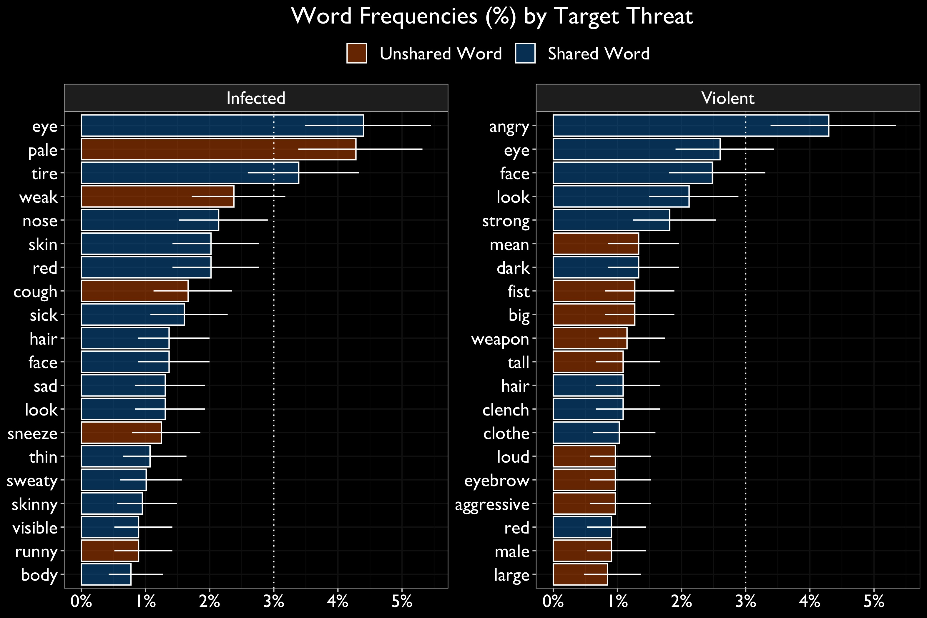
Notes:
These are the top 20 words used to describe each threat category. The y-axis represents the word and the x-axis represents the percentage. Error bars represent 95% profile confidence intervals. Words used only for one threat category re red. Words that occurred across threat categories are blue. For example, people used words like eye and face and red to describe traits for both threats. But People used pale and tired and week to describe infected people and they used mean and fist and big to describe violent people. These words are of course more informative in context.

Slide 64
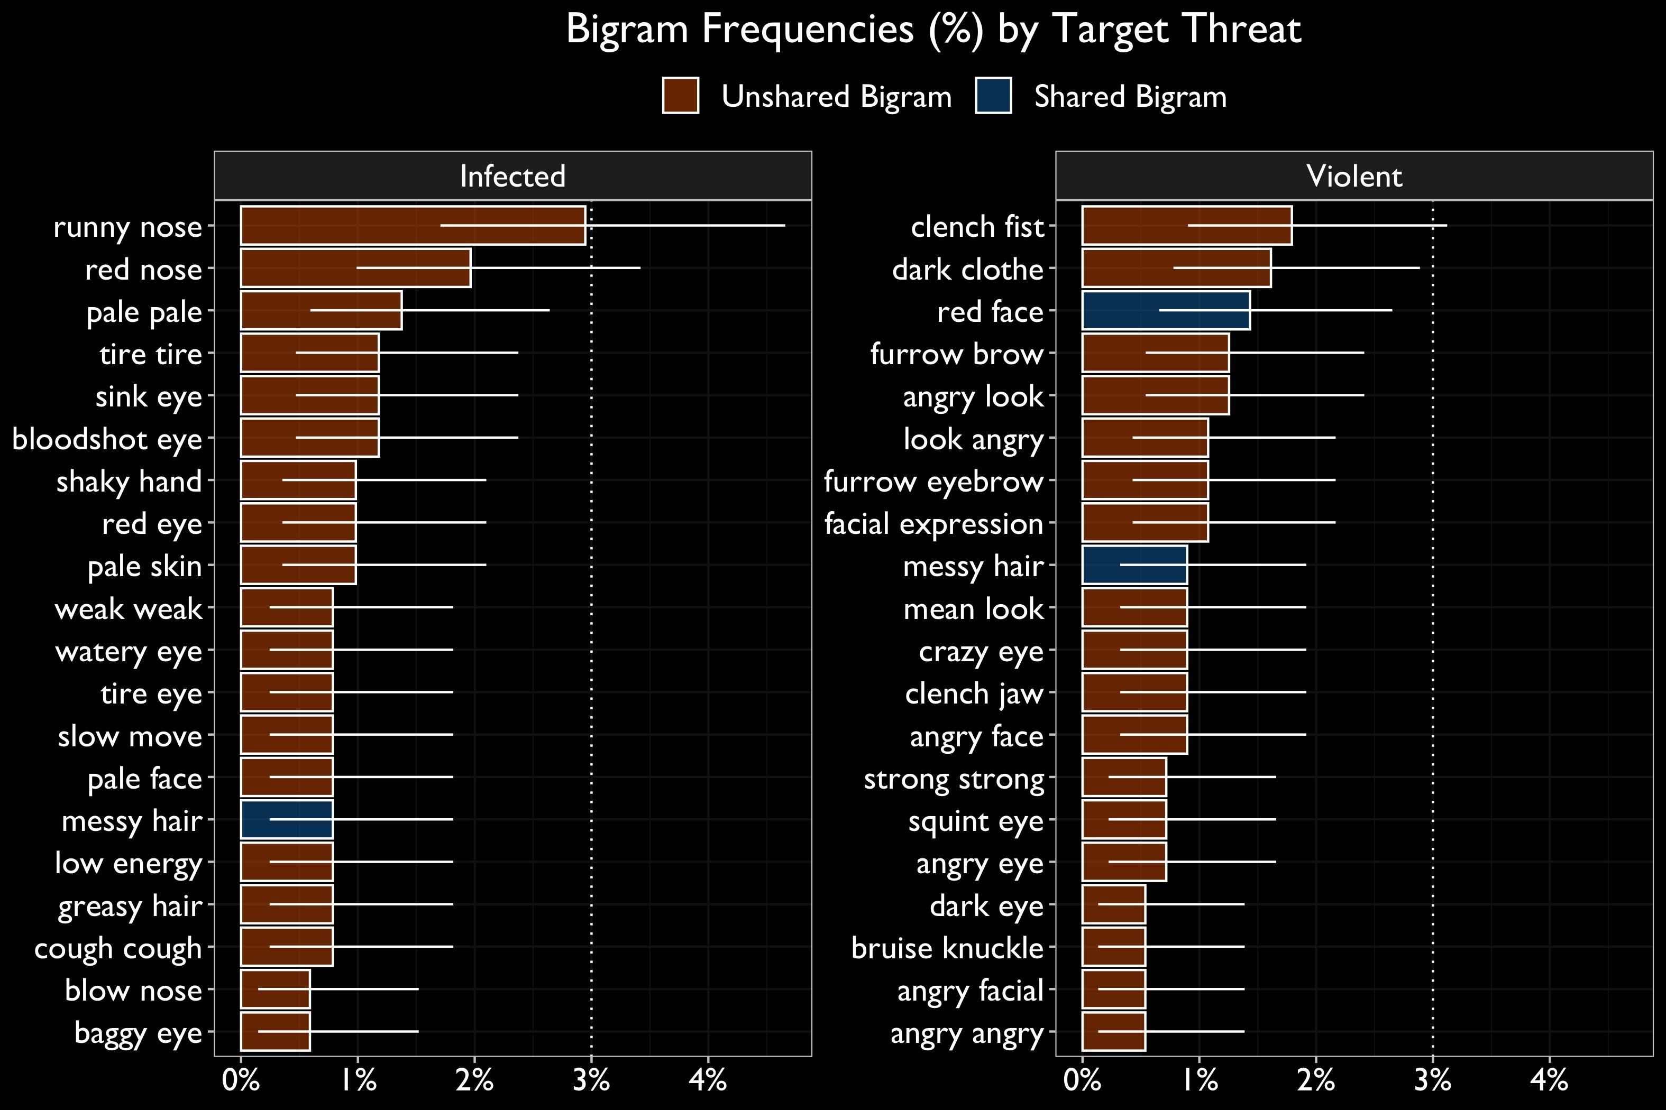
Notes:
So it’s a little more informative to look at bigrams which is a fancy data science word for two words next to each other. As you can see, way fewer bigrams appear across threat categories than single words. Infected people were often descrived as having runny noses, sunken eyes, bloodshot eyes, shaky hands. In contrast, violent people were described as having clenched fists, dark clothes, red face, and furrowed brows.

Slide 65
Study 1 Takeaways
People listed traits of infected and violent people consistent with the threat-specific hypothesis
Notes:
The main thing I want you to take away from this is that people listed traits of infected and violent people consistent with the threat-specific hypothesis.

Slide 66
Study 2 Goals
Draw pictures of infected and violent people (as a comparison)
Recruit independent raters to rate subjective features they see in the drawings
Notes:
For the second study, our goal was to collect drawings of infected and violent people. And we planned to have independent raters rate these drawings on subjective features.

Slide 67
We asked participants to draw both a Germy and a Violent representation (which we defined for them)
Germy Definition. full of germs; germ infested; appearing either sick or contaminated
Violent Definition. prone to commit acts of violence; uses physical force intended to hurt, damage, or kill someone or something
Collected ~ 150 pairs of drawings
Notes:
We asked participants to draw both a Germy and a Violent representation (which we defined for them)

Slide 68
We had raters rate either 5 germy drawings or 5 violent drawings
0 = Not at all, 8 = Extremely
How clear is this image?
How germy is this person?
How disfigured is this person?
How old is this person?
How heavy is this person?
How oreign is this person?
How atigued is this person?
How healthy is this person?
How violent is this person?
How angry is this person?
How dominant is this person?
How muscular is this person?
How masculine is this person?
Notes:
And then we had independent raters rate either 5 germy drawings or 5 violent drawings.

Slide 69
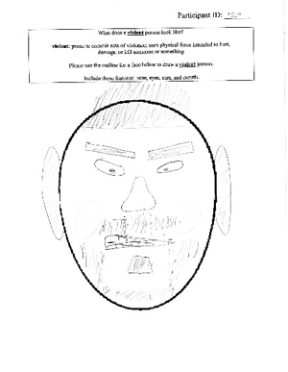
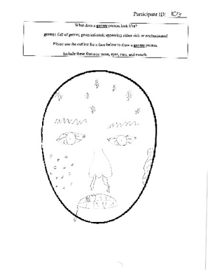
Rated Extremely Violent
Rated Extremely Germy
Notes:
Here are some extreme examples to impress you. A drawing rated extremely violent on the left and extremely Germy and the right.

Slide 70

Germy drawings appeared with stronger-looking infection-related features and violent drawings appeared with stronger-looking violence-related features
Notes:
Germy drawings appeared to have some stronger infection-related features (e.g., germy, disfigured, fatigued, unhealthy) than infection-unrelated features (e.g., violent, angry, dominant). For between-category effects, the Germy drawings in Study 2 were rated more germy, more fatigued, and less healthy than the Violent drawings (which were rated more violent, angry, old, and dominant than Germy drawings)

Slide 71

Analysis 2. Between-Threat Ratings Differences
Notes:
First I’m going to show you mean differences between threat categories.

Slide 72
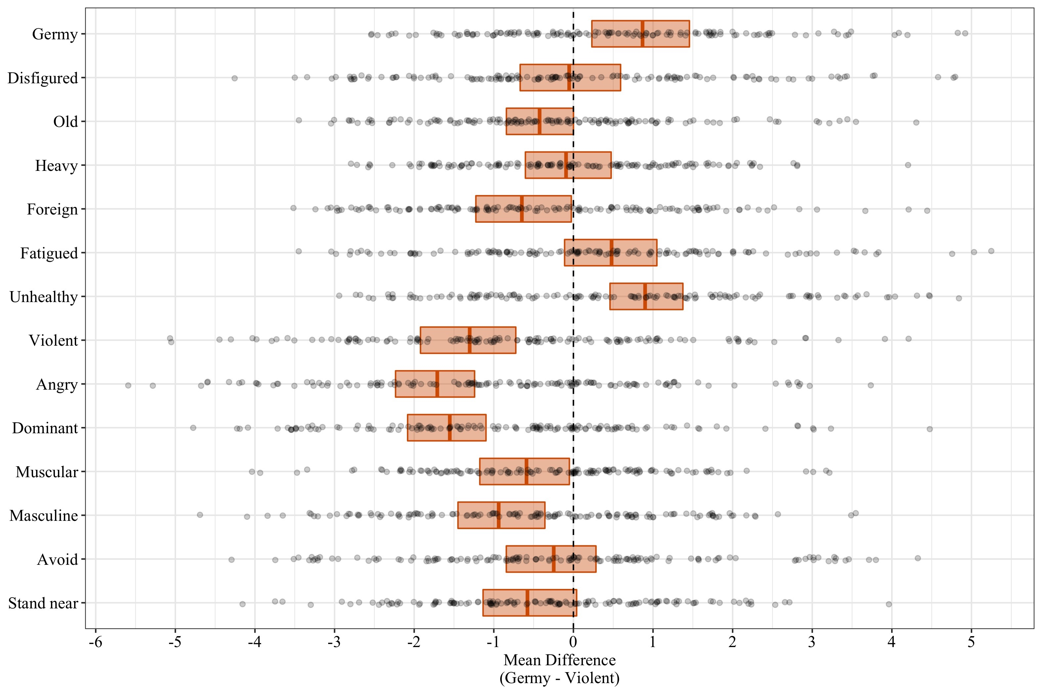
Notes:
Here are the results of a fancy regression model. On the y-axis, you can see labels for each of the subjective features, and on the x-axis you can see the difference between the two types of drawings from the same artist. The bars represent bootstrapped 95% confidence intervals.
Bars further to the right mean the Germy drawings were rated higher on average, and bars further to the left mean the Violent drawings were rated higher on average. I’ve highlighted the subjected features associated with infection from the behavioral immune system literature. As you can see, the germy drawings appeared less healthy and less fatigued and more germy than the violent drawings, but the differences on the other subjective traits were consistent with zero or nonsignificant.

Slide 73
Analysis 1. Within-Threat Ratings Differences
(Mean ratings of only the Germy drawings)
Notes:
Now I’ll show you means within the Germy category. This means I’m going to show you mean ratings for the germy drawings

Slide 74
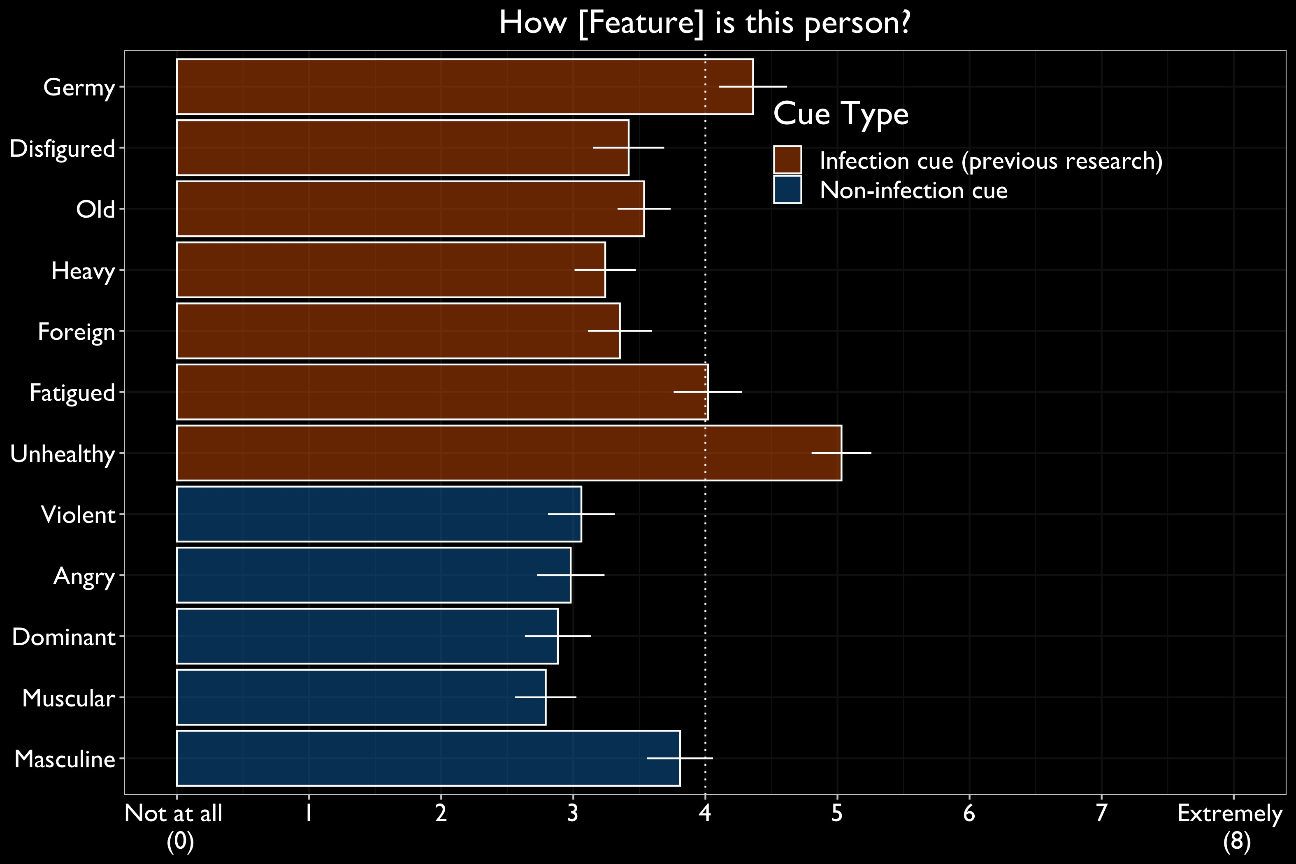
Notes:
The y-axis represents the features and the x-axis represents the response scale. Error bars represent 95% confidence intervals. Now it’s a little clearer that the Germy drawings have stronger infection-related features. You can think of this in terms of exceeding the midpoint of the scale but you can also think of it in terms of comparing the means to eachother. For example, the germy drawings were rated more unhealthy than they were rated violent, angry, dominant, muscular, or masculine, on average. The same thing applies to the germy and fatigue ratings. The formal way to do this is just test all pairwise comparisons and apply a Bonferroni correction.

Slide 75
Study 2 Takeaways
People drew pictures of infected and violent people consistent with the threat-specific hypothesis
But there was some overlap in how violent infected drawings looked and how infected violent drawings looked
Notes:
Read slide

Slide 76

Study 3, 4, & 5 Goals
Use reverse correlation 2-image forced-choice classification task to estimate mental images of germy, infected, and violent people (for comparison)
Recruit independent raters to rate subjective features they see in the proxy mental images
Notes:
For the last three studies, our goal was to use an image classification task to estimate mental images of germy, infected, healthy, and violent people. Like with the drawings, our plan was to recruit independent raters to rate subjective features of the mental images.

Slide 77
Experimentally manipulated features vs. Reverse Correlation images
Experimentally manipulated features
Estimate the effect of one or a few features on psychological outcomes
Example. What’s the effect of facial birthmarks on infection judgments?
Reverse Correlation
Randomly vary features and have participants select a category of interest from many pairs of images
Example. What does an infected person look like?
Notes:
I want to take a moment to explain reverse correlation in comparison to a more traditional approach of experimentally manipulating one or a few features. When researchers experimentally manipulate features, they’re interested in the effect of one or a few features on psychological outcomes. For example, what’s the effect of facial birthmarks on infection judgments. Reverse correlation flips the question in away. Instead of holding features constant, reverse correlation procedures randomly vary features and have participants select a category of interest from many stimuli. Researchers use this procedure when they’re interested in questions like what does an infected person look like?

Slide 78
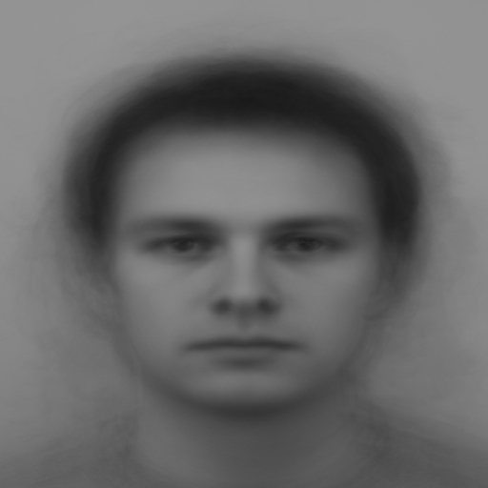
Base image
Notes:
We start with a base face, a gray scale average of all male faces in the Karolinska Face Database (used in prior RCP research)

Slide 79
Random Noise Pattern
Notes:
We create hundreds of randomly generated noise patterns that will be superimposed on the base face.

Slide 80
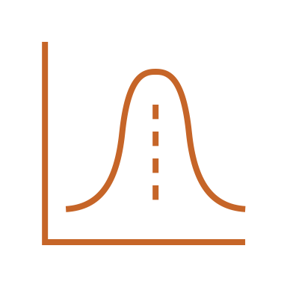
We superimpose these noise patterns onto the base face to mimic randomly varying facial features
Notes:
read slide

Slide 81
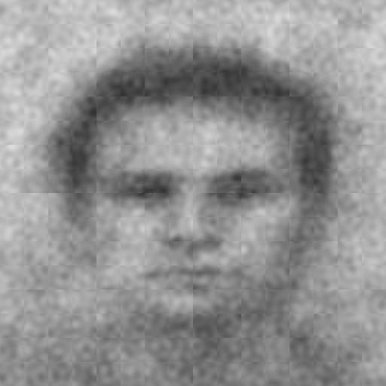
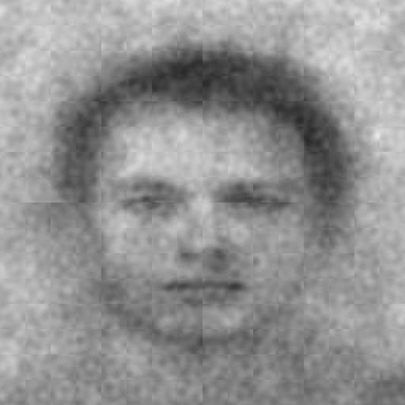
Which face looks more [insert trait]?
Base image with
original noise superimposed
Base image with
the negative noise superimposed
Notes:
On the left a random noise pattern has been superimposed onto the base face.
So on the right the negative noise pattern is superimposed on the base face. Basically every dark pixel in the original noise pattern is light in the negative.
So participants will see somewhere between 300 and 700 of they’ll select which face in a given pair looks most like some trait. It cab be whatever you want.

Slide 82
Notes:
During the task, participants first they see a centered fixation cross for 1 second.

Slide 83
Which face looks more infected?
Notes:
Then they make a choice.

Slide 84
Notes:
Then they see another fixation cross.

Slide 85
x 400 Trials
Notes:
They do this 400 times.

Slide 86



Mental Image = Average of images participants selected
3
Notes:
And then we take noise patterns from their selections, average them together, and place that average pattern onto the base image. That represents the mental image of the social category they were asked to look for in the stimuli.

Slide 87
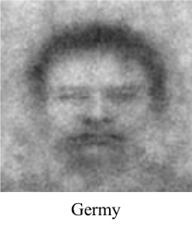
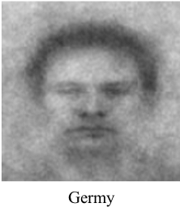
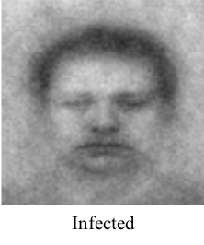
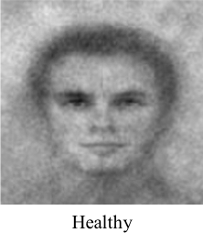
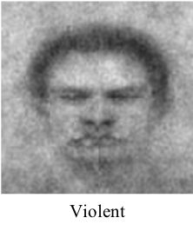
Studies 3-5. Mental Images
Study 3
Study 5
Study 4
Study 4
Study 5
Notes:
read slide

Slide 88
We had raters rate the germy, infected, healthy, or violent mental images
0 = Not at all, 8 = Extremely
How clear is this image?
How germy is this person?
How disfigured is this person?
How old is this person?
How heavy is this person?
How foreign is this person?
How fatigued is this person?
How healthy is this person?
How violent is this person?
How angry is this person?
How dominant is this person?
How muscular is this person?
How masculine is this person?
Notes:
We had raters rate the germy, infected, healthy, or violent mental images.

Slide 89
Studies 3-5 Results
Germy and Infected images appeared with a mix of stronger-looking infection–related and violence-related features than Healthy images
Notes:
read slide

Slide 90
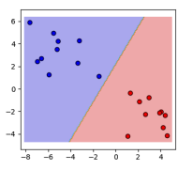
Linear Discriminant Analysis
Maximize the separability between groups
Structural coefficients index to the degree to which variables contribute to maximal separation
Notes:
Before I show you this graph, I want to give you an intuition about the analysis. I used linear discrimant analysis for two reasons. The goal here is to find the best way to distinguish the groups using the ratings of the groups mental images. From this analysis, I can extract coefficients that index to the degree to which each variable contributed to the maximal difference.

Slide 91
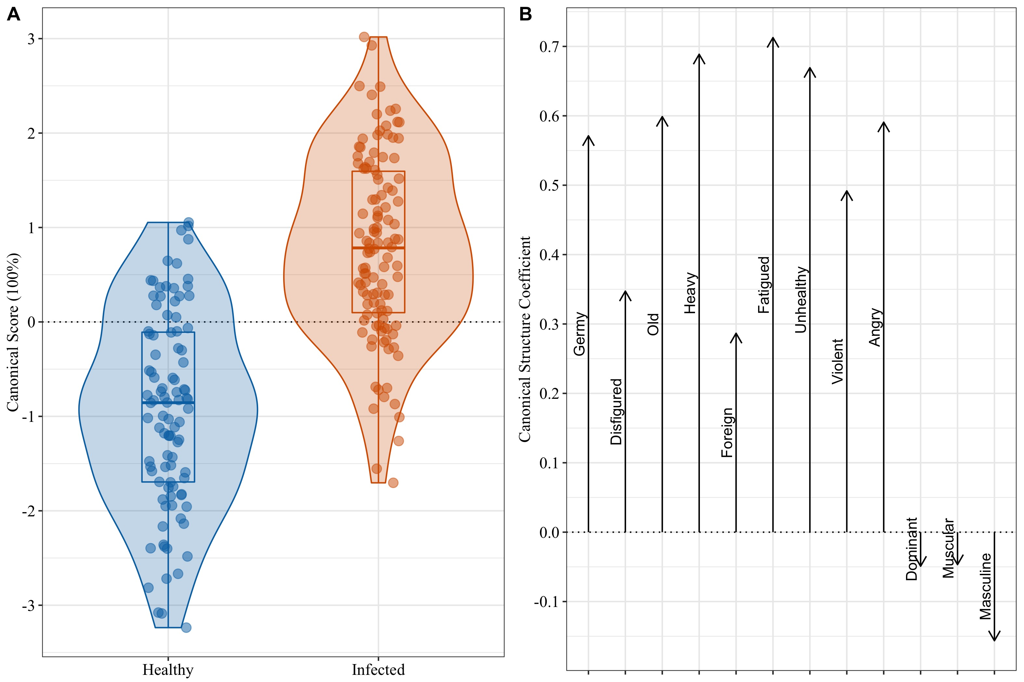
Notes:
The left plot depicts predicted scores for each group. Remember, the goal of the analysis was the max their difference as big as possible, so it shouldn’t be surprising that they look different. But the real useful information is in the right plot. You can interpret these arrows like partial correlations, where taller arrows mean that variable contributed more to the maximal difference. So, in this case, the Infected image looked differently than the healthy image because it looked more germy, more disfigured, heavier, more fatigued, more unhealthy, more violent, and angrier, In contrast, dominance, muscularity, and masculinity contributed much less to the differences between the images.

Slide 92
Studies 3-5 Results
Violent images appeared with stronger-looking threat features—both infection-related and especially violence-related—than Germy Images
Notes:
Now I’ll show you the same analysis comparing Violent to Germy mental images. (read slide)

Slide 93
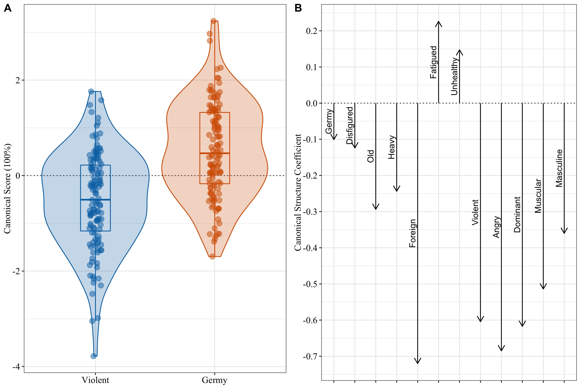
Notes:
Again, these subjective features do contribute to perceived differences between the images. They’re obviously distinct images. In this case, they’re most different because the Violent image looks more foreign, violent, angry, dominant, muscular, and masculine. In contrast, the images look most different in part because the germy image looked more fatigued and unhealthy.

Slide 94
Studies 3-5 Results
Infected images appeared to have a mix of infection-related features and infection-unrelated features

Slide 95
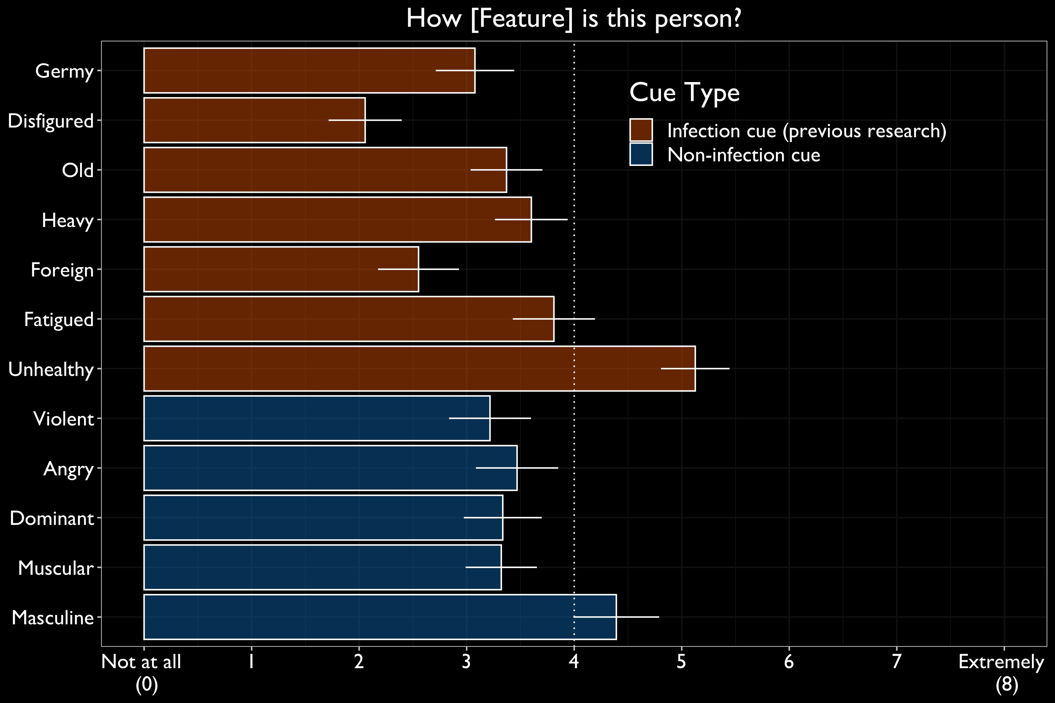

Slide 96
Studies 3-5 Results
Objective pixel-luminance values of the Germy and Infected images correlated more strongly with each other than with those from the Violent images
Notes:
Next, I want to show you some results that are little more objective. Each image is essential a huge matrix of pixel values. I can use these to compute correlations between the images. When I did this, I found the germy and infected images correlate more strongly with eachother than with the violent image.

Slide 97
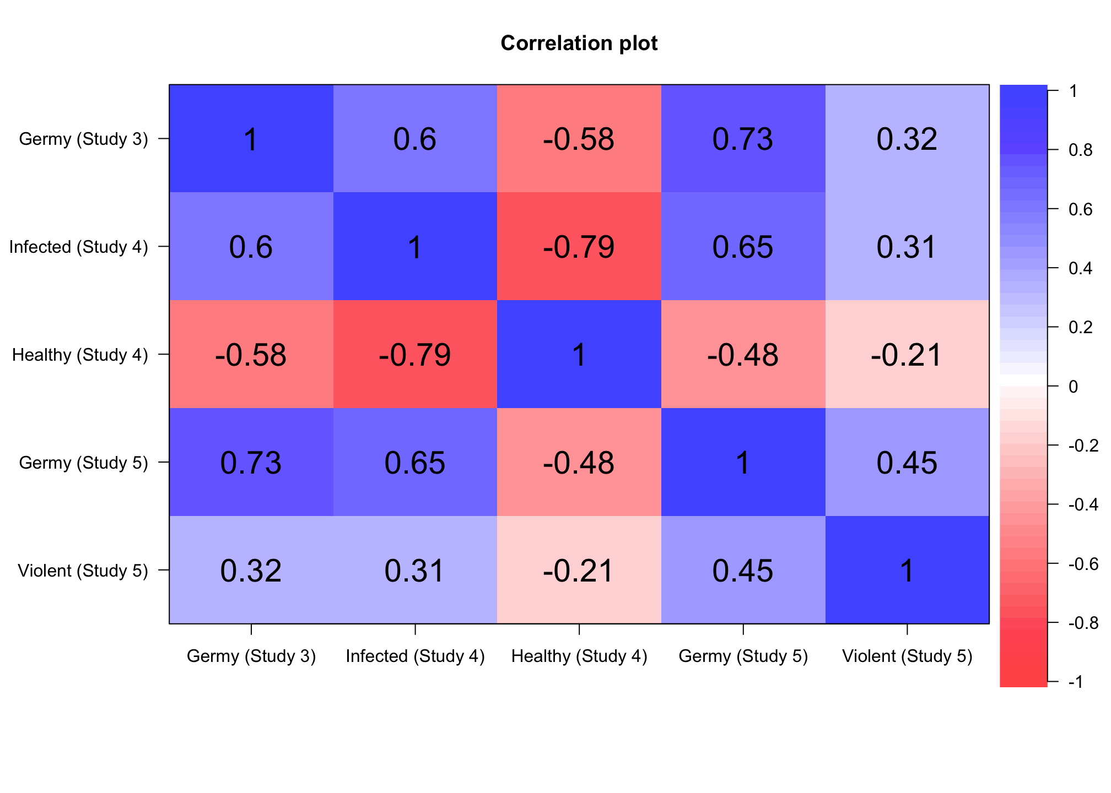
Notes:
As you can see, independent germy, infected, and healthy images strongly correlate with each other and less strongly with the violent image. This is simply consistent with the hypothesis that people are generating distinct images for these different threats.

Slide 98

Study 3, 4, & 5 Takeaways
People generated mental images of germy, infected, healthy, and violent people consistent with the threat-combination hypothesis
Although different threat images appeared with a combination of threatening features, the images themselves were meaningfully distinct
Notes:
That said, given the overlap in perceived threatening features, the infected, healthy, and violent images appeared consistent with the threat-combination hypothesis

Slide 99

Empirical Takeaways
Studies 1 & 2. People listed traits for and drew pictures of infected and violent people with predominantly threat-specific features
Studies 3-5. People generated mental images of germy, infected, healthy, and violent people with a combination of infection-related and violence-related features

Slide 100

Methods Takeaways
Trait listing and drawings tasks seemed to elicit expectation-driven results
Reverse correlation tasks seemed to elicit less expectation-driven results
Different mental representation methods can yield hard-to-reconcile results

Slide 101

Theoretical Takeaways
People can mentally distinguish between different kinds of threatening others
“Constrained” or “Implicit” or “Automatic” mental representations of threats could be less threat-specific

Slide 102

Open Science
Theoretically-motivated exploratory studies
We preregistered nearly every study
We’ve made all our preregistrations, materials, data, and analysis scripts available in an online repository
None of this make the studies better, just more verifiable
Notes:
While I have impressionable minds in the room, I want to quickly go over our open science practices. (read the slides)

Slide 103
Michalak, N. M., & Ackerman, J. M. (2020). A Multimethod Approach to Measuring Mental Representations of Threatening Others. Journal of Experimental Psychology: General. http://dx.doi.org/10.1037/xge0000781 Online Repository https://osf.io/84vdp/

Slide 104
Thank you
nickmichalak.com

